Slide 2
Class 22
Tasks: Debugging ML

Slide 3
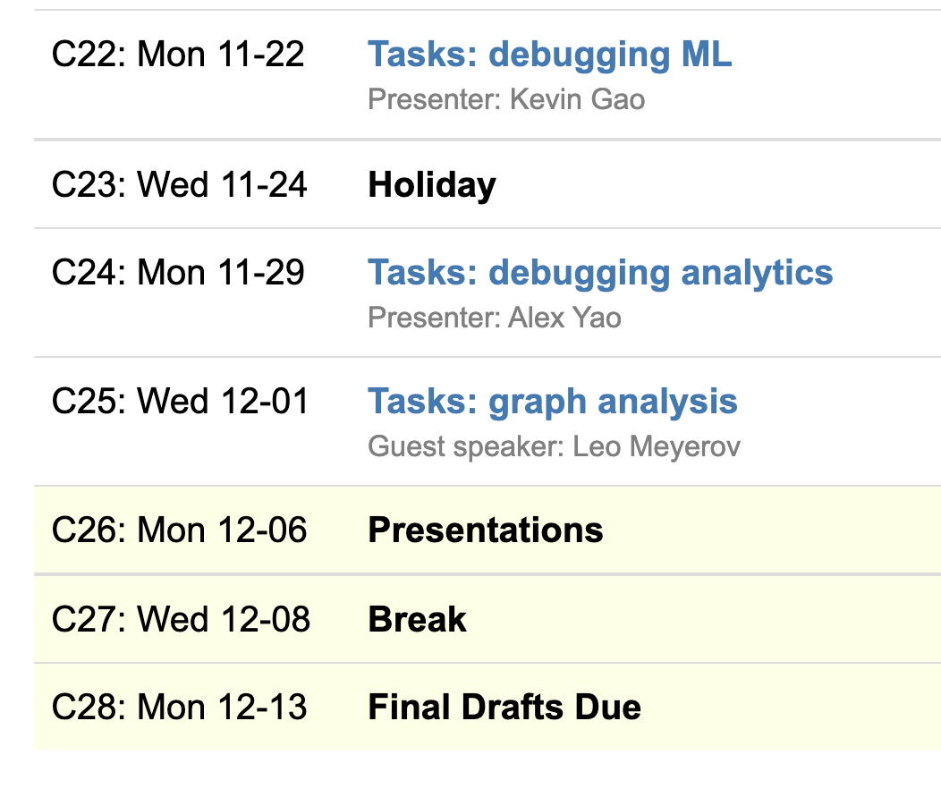
Logistics
Student & guest classes
Showcase on 12/6

Slide 4
Class 20
Tasks: Events

Slide 5
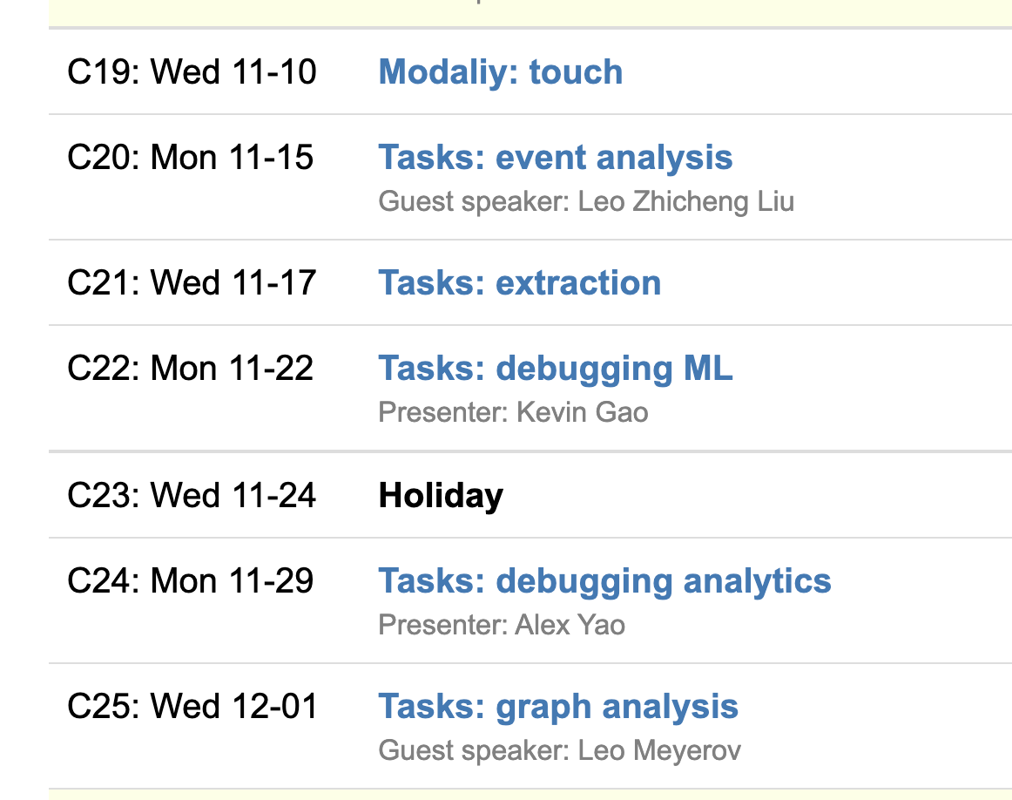
Logistics
A4 due Tuesday 11:59PM EST
Student & guest classes after Weds
Showcase on 12/6

Slide 6
A4
Run locally using duckdb
https://github.com/columbiaviz/dbt-assignment

Slide 7
Reviews
Harassment in video game chat rooms
Software product user evaluation
Fantasy Football
Story writing
Log analysis
Fried chicken TV ads
TCP/IP analysis
On-call incident analysis
Finance
Social network tracking
NLP

Slide 8
Showcase Logistics 12/06
9(!!) groups
Each team: 5 min presentation, 3 min feedback
Every team member should speak
Timing is strict, so practice!

Slide 9
Presentation Slides Submission
Submit slides via Google form (TBA)
Google slides strongly preferred
Each team submits once
Deadline for slide submission
Friday, 12/03/2021 11:59 PM

Slide 10
Showcase Details
Presentation should contain (in substance, not necessarily slides)
Motivation and hypotheses
Technical challenge and contribution
Related work and how they are related
Simple example to illustrate idea
Technical insights/experimental findings so far
Demos as GIFs or embedded videos
Feedback: 1-2 questions you’d like feedback on

Slide 11
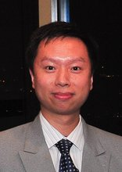
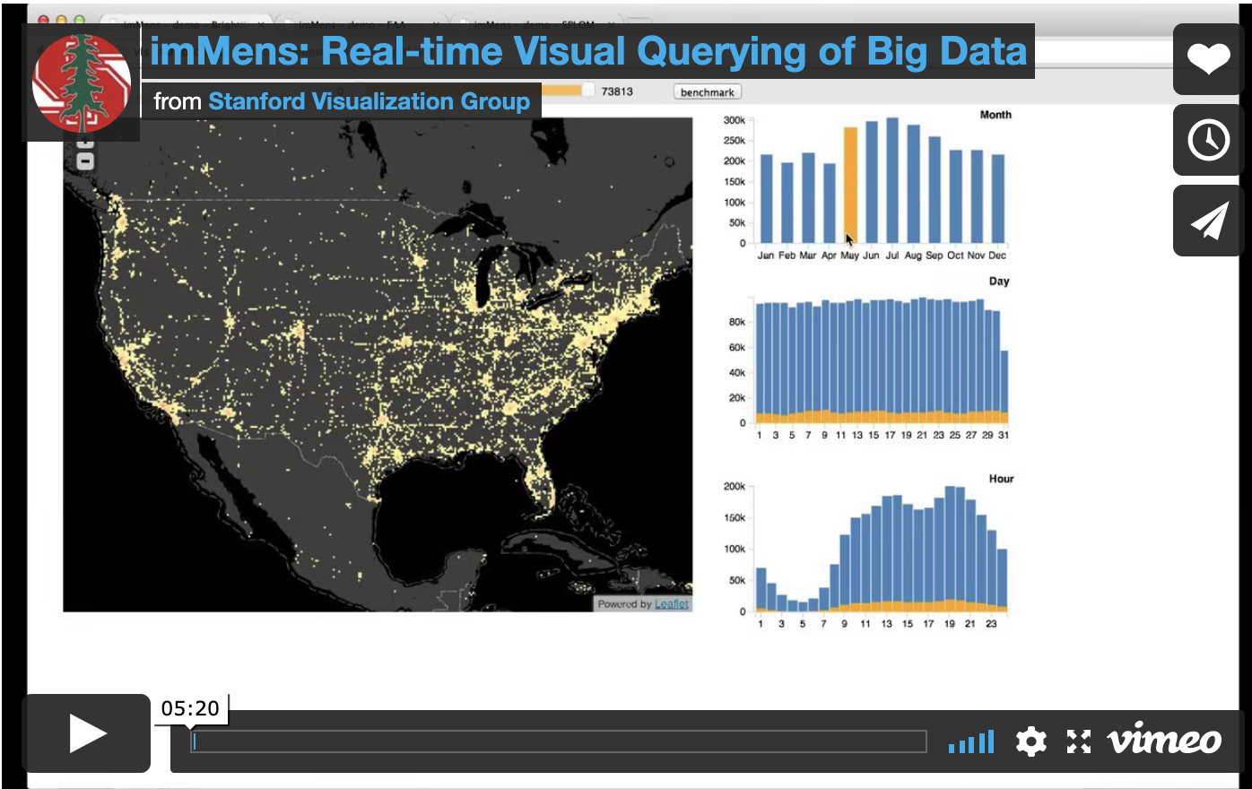
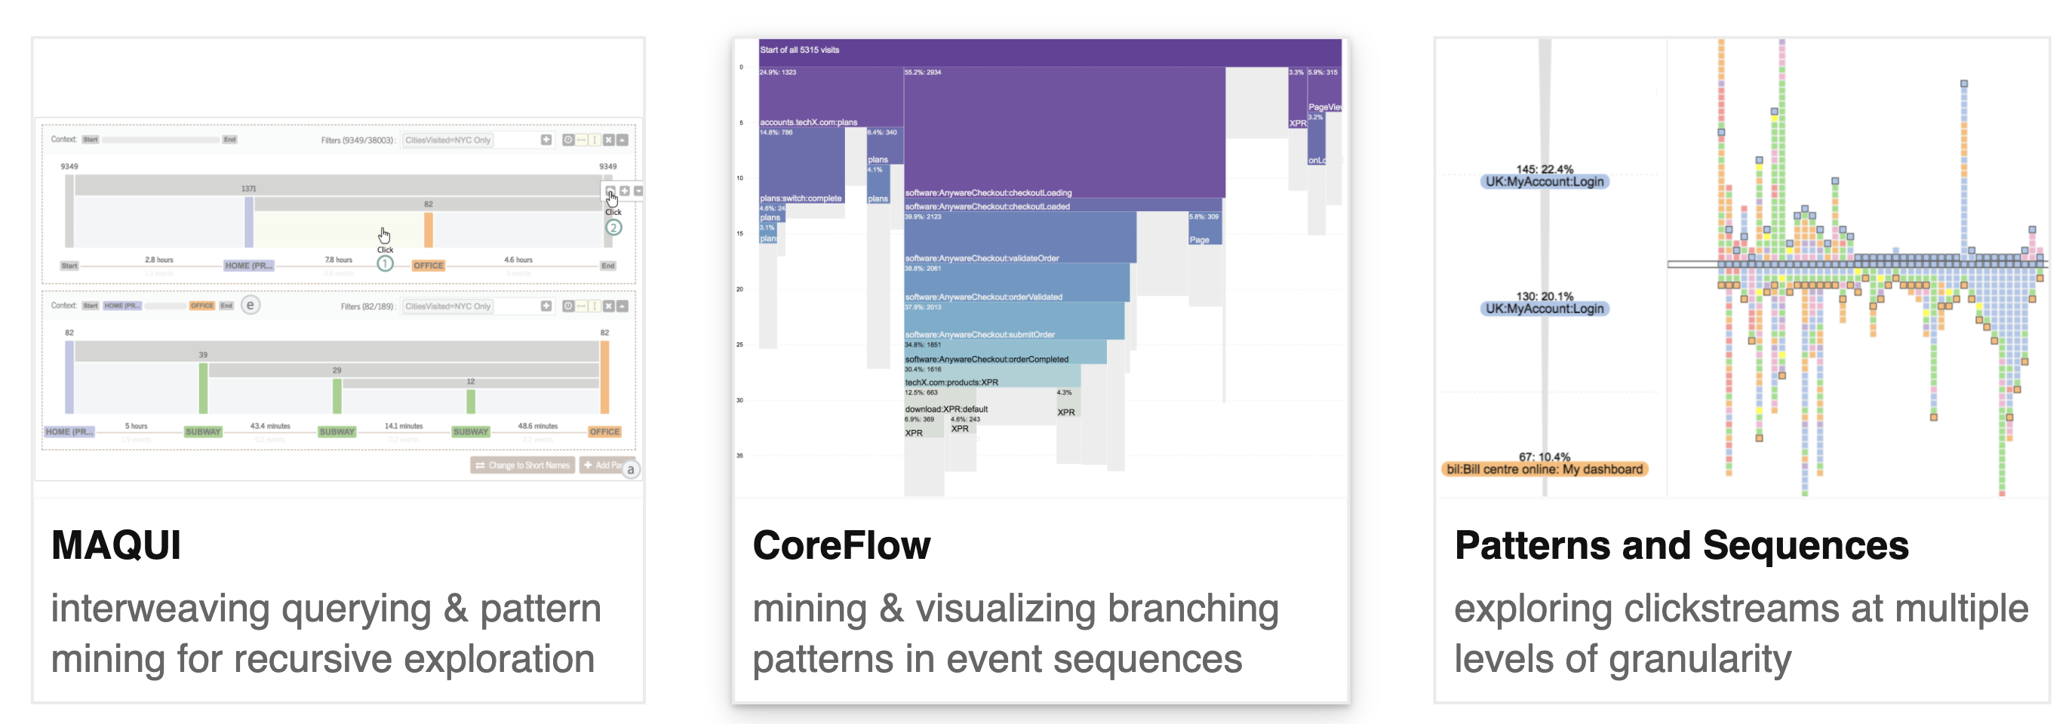
Leo Zhicheng Liu U Maryland, College Park

Slide 12
Class 16
Modalities: Spreadsheets

Slide 13
Logistics
If you are sick, talk to me to arrange a special-case zoom
A4 released later today (use #A4 channel on slack)

Slide 14
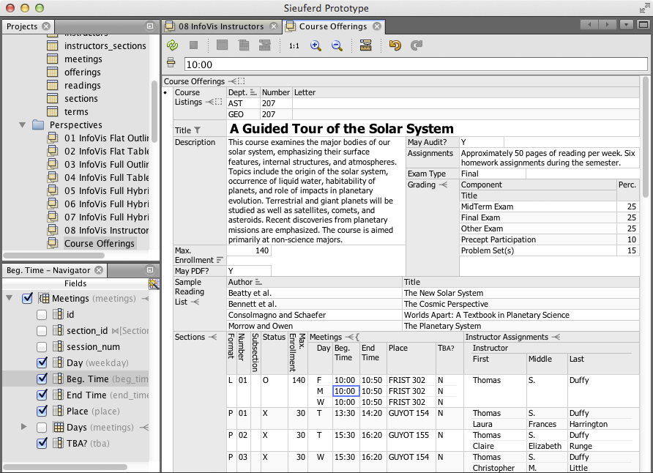

Eirik Bakke: Spreadsheets

Slide 15
Each group assigns notetaker
Our model of HDIs is based on language (expressiveness), task, visual representation, and interactions.
Contrast two spreadsheet systems from A3 in terms of our model.
Notes:
How did you pick the other vis language?

Slide 16
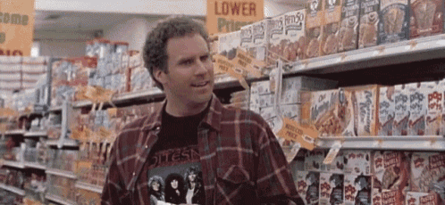
Support your colleagues
for speaking up!

Slide 17
Each group assigns notetaker
Our model of HDIs is based on language (expressiveness), task, visual representation, and interactions.
Contrast two spreadsheet systems from A3 in terms of our model.
Notes:
How did you pick the other vis language?

Slide 18
Class 15
Modalities: Voice and Text

Slide 19
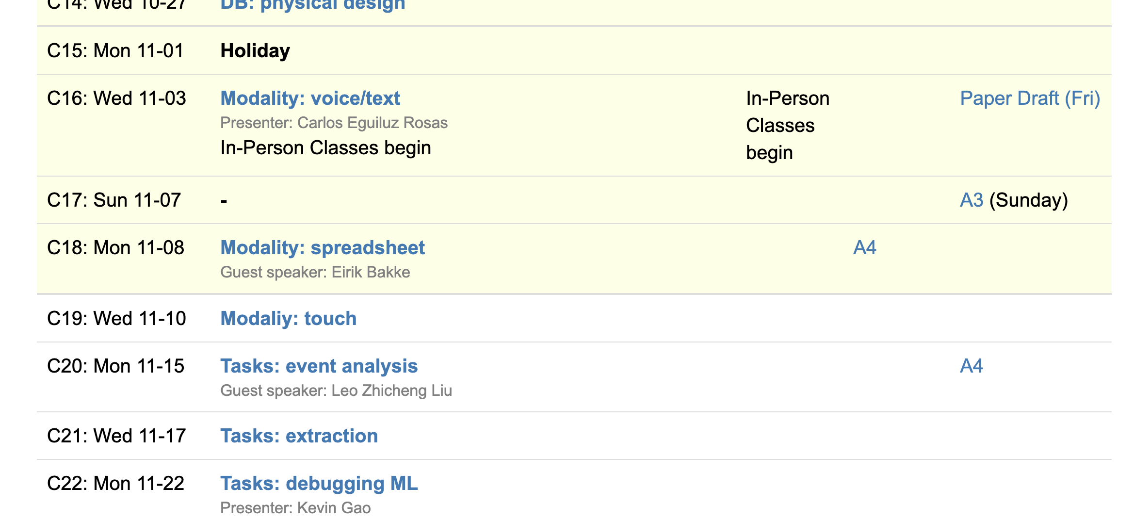
Logistics
Drafts due Friday
A3 due Sunday
A4 out next week
Eirik on Monday

Slide 20
Class 14
Physical Design

Slide 21
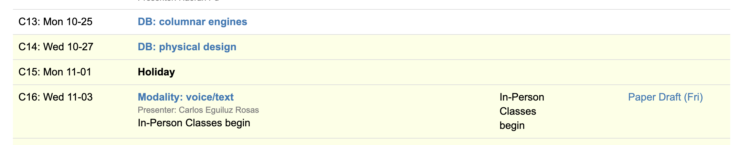
Logistics
In-person-only on Nov 3 after election holiday
Office hours Thursday 1pm (next week only)
Final class on performance
VIS today to Friday

Slide 22
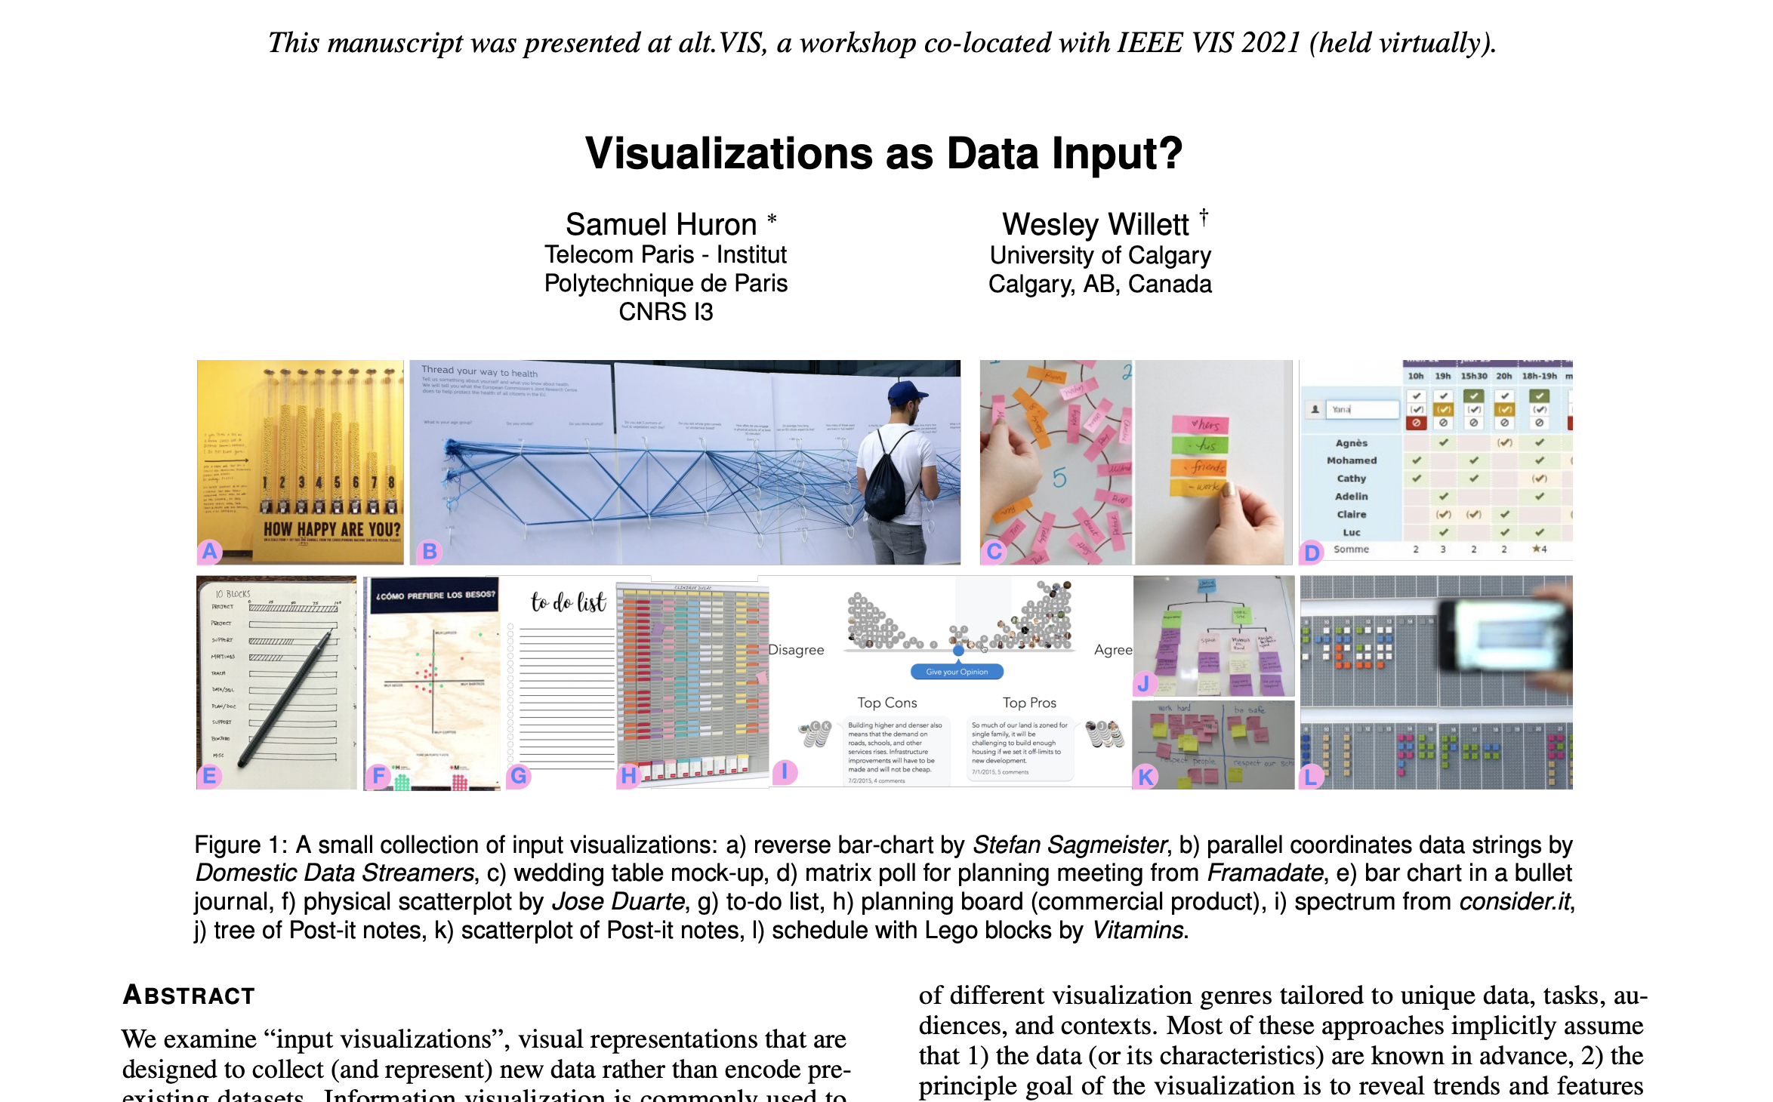

Slide 23
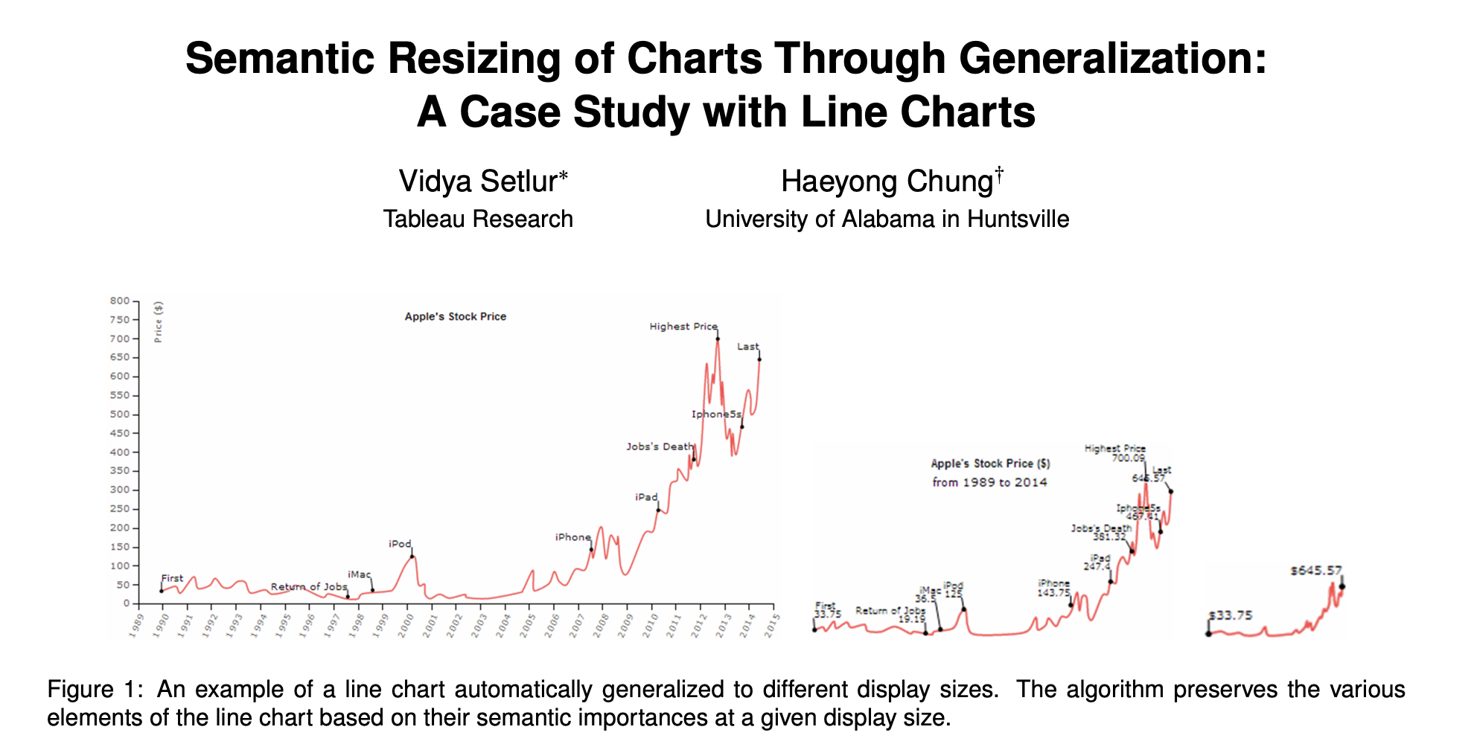

Slide 24
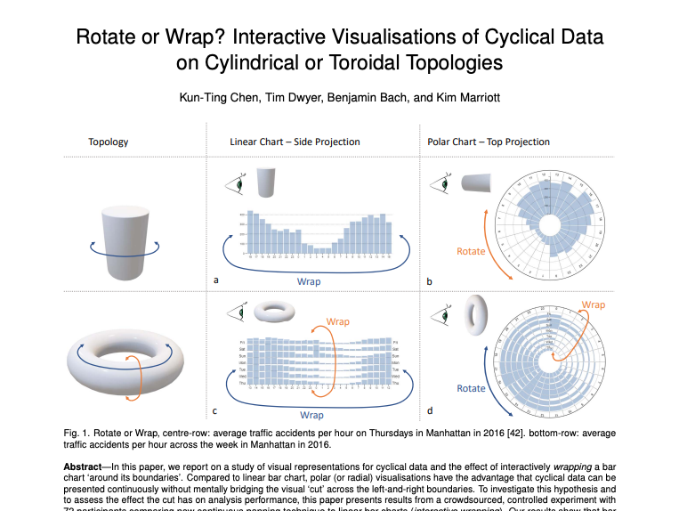
Wrappable Vis (monash.edu)

Slide 25
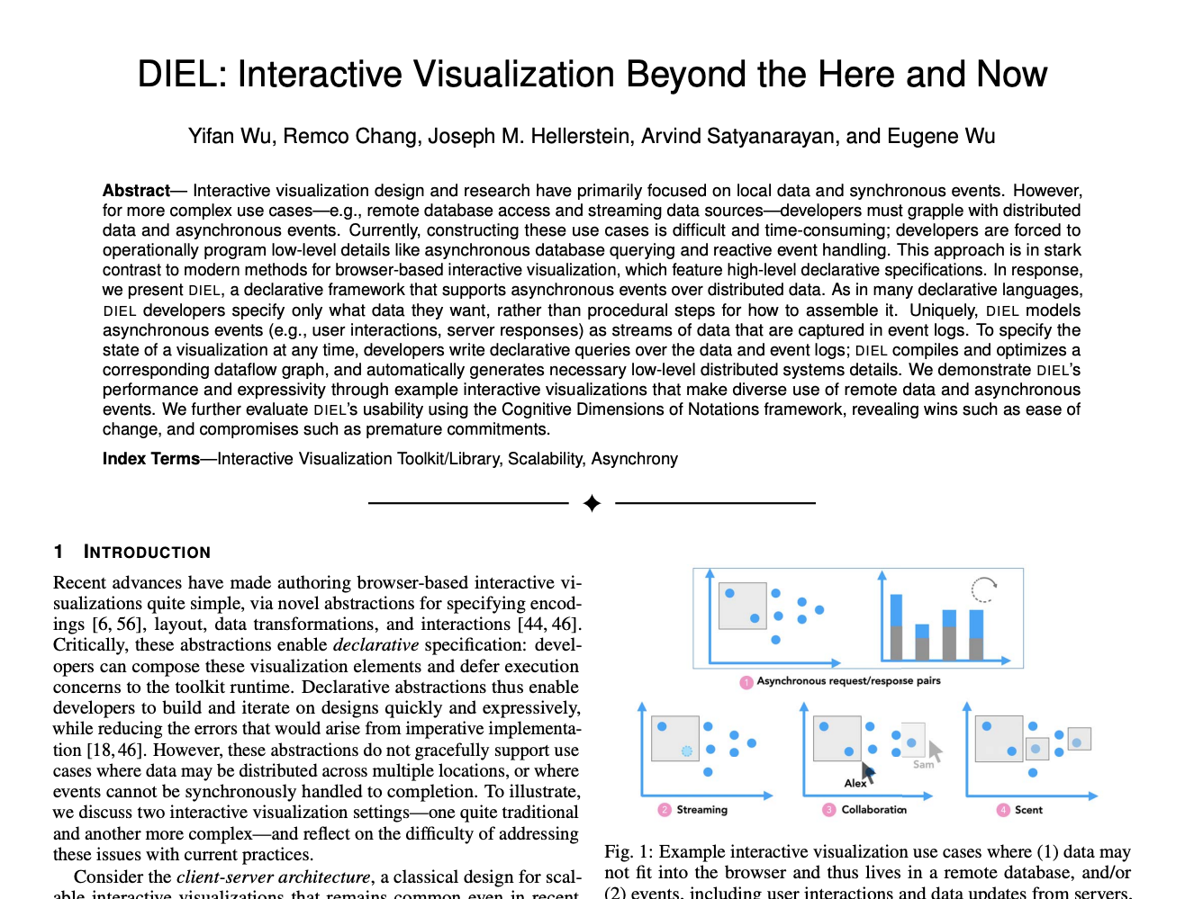

Slide 26

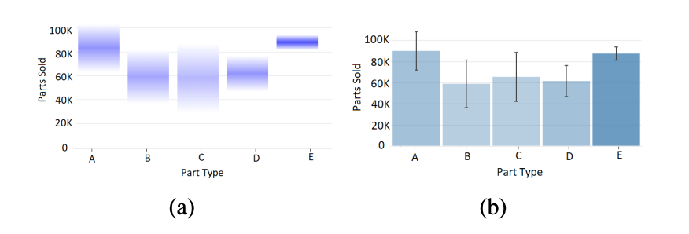

Slide 27
Each group assigns notetaker
What properties from AutoAdmin’s physical design problem are useful for optimizing human data interfaces? What aspects of its optimization problem do NOT apply?
Notes:
How did you pick the other vis language?

Slide 28

Support your colleagues
for speaking up!
2 Thumbs 4 SPEAKING UP

Slide 29
Each group assigns notetaker
What properties from AutoAdmin’s physical design problem are useful for optimizing human data interfaces? What aspects of its optimization problem do NOT apply?
Notes:
How did you pick the other vis language?

Slide 30
Class 13
Columnar Execution

Slide 31
Logistics
In-person-only on Nov 3 after election holiday
Spreadsheet assignment out!

Slide 32
Each group assigns notetaker
The reading mentioned column groups. What factors would determine the “best” column grouping?
Notes:
How did you pick the other vis language?

Slide 33
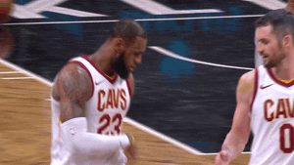
Support your colleagues
for speaking up!

Slide 34
Each group assigns notetaker
The reading mentioned column groups. What factors would determine the “best” column grouping?
Notes:
How did you pick the other vis language?

Slide 35
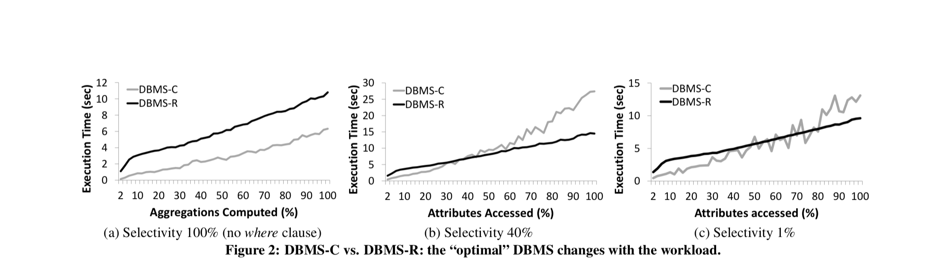
SELECT a, b, …. FROM data WHERE a > ? and b > ? and ….

Slide 36


Slide 37
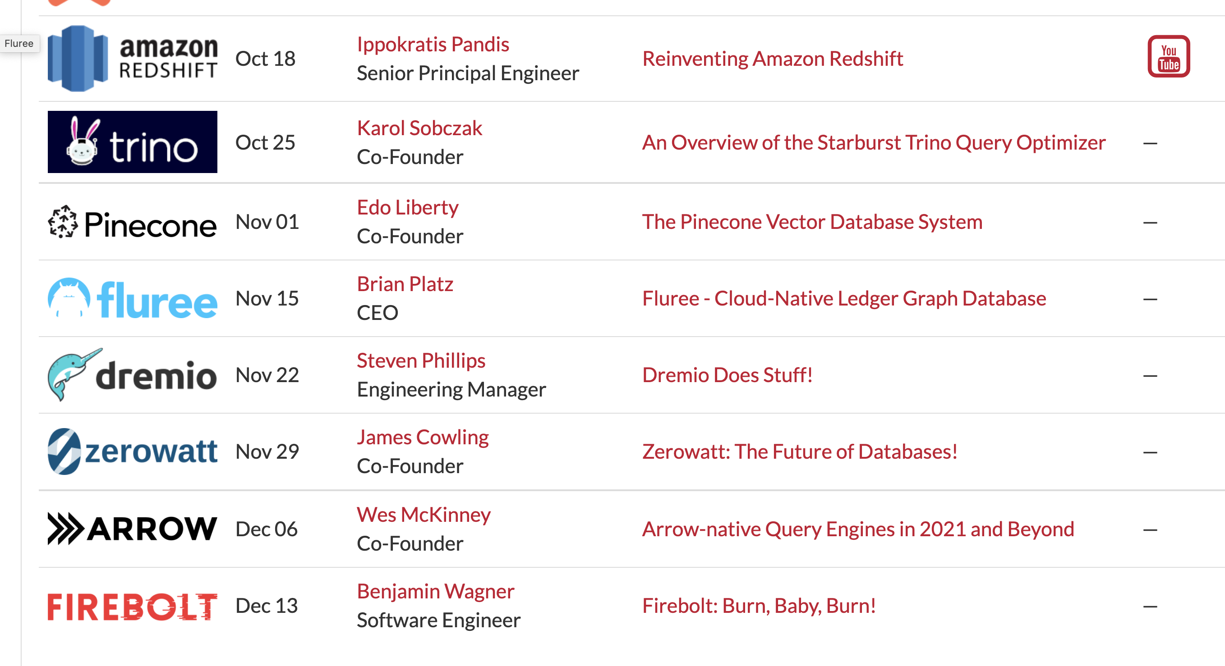

Slide 38
Class 12
Approximation and Materialization

Slide 39
Logistics
Haoran Pu discusses today’s readings
In-person-only on Nov 3 after election holiday
Spreadsheet assignment out Friday

Slide 40
Reviews
Sample creation takes a significant amount of time (5-30 minutes)… It doesn't seem like we would use BlinkDB for analytical workloads in which new data is always incoming.

Slide 41
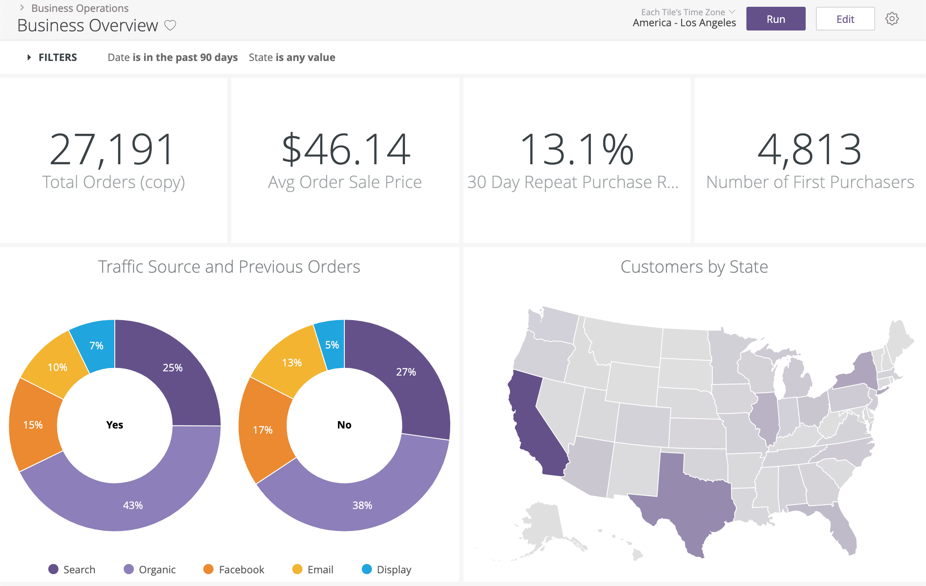
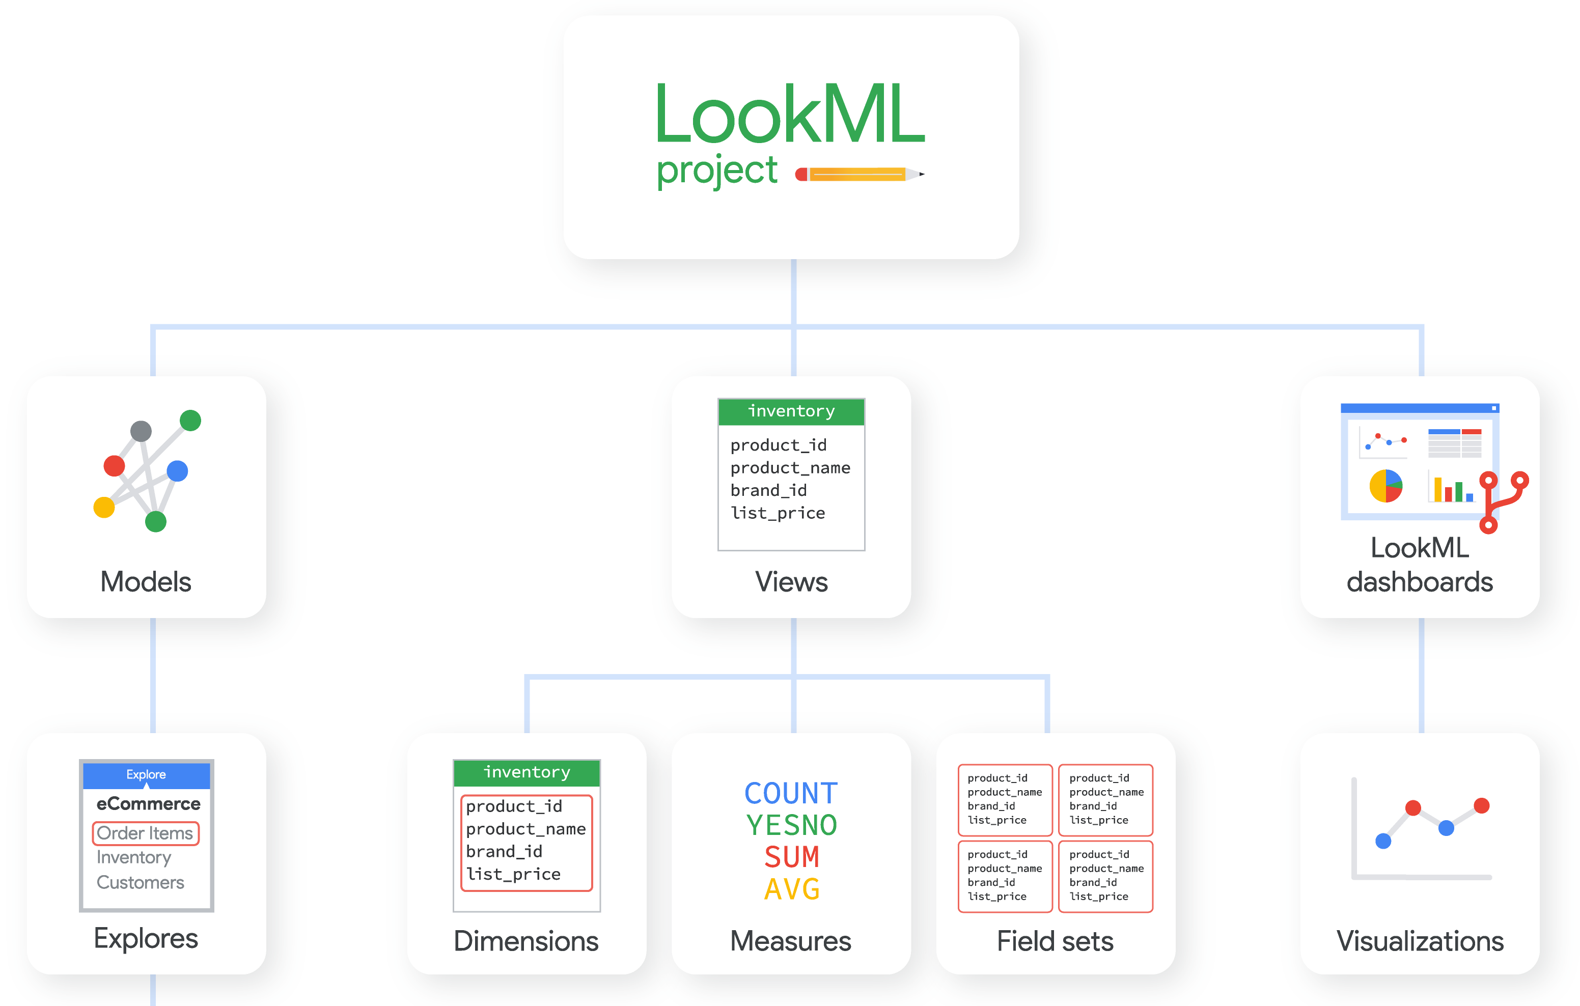
Reviews
Data cubes are no good for non-expert. As users have to define key measurements for the data cube. This means the interface user should be professional rather than a user who just wants to explore the data set.

Slide 42
Malloy from Looker
SQL is complete but ugly:
everything is expressible, but nothing is reusable;
simple ideas are complex to express;
the language is verbose and lacks smart defaults.
explore 'malloy-data.ecomm.order_items' | reduce
status
order_item_count is count(*)
https://github.com/looker-open-source/malloy

Slide 43
Each group assigns notetaker
What interface characteristics make approximation
more applicable than building data cubes (or vice versa)?
​Construct an example
Notes:
How did you pick the other vis language?

Slide 44

Support your colleagues
for speaking up!

Slide 45
Each group assigns notetaker
What interface characteristics make approximation
more applicable than building data cubes (or vice versa)?
​Construct an example
Notes:
How did you pick the other vis language?

Slide 46
Class 11
Optimization Overview and Col Stores

Slide 47
Logistics
Jeffrey Tao discusses today’s readings
In-person-only on Nov 3 after election holiday
Spreadsheet assignment out Friday

Slide 48
Projects
Main feedback
Hypothesis
Narrow scope
Related work
System
User Study
Hypothesis/Question
Interview

Slide 49
Projects
Main feedback
Hypothesis
Narrow scope
Related work
Not Here!
Start HERE!
System
User Study
Hypothesis/Question
Interview
Is it novel?
Is it worth asking?
Is it answerable?

Slide 50
Reviews
Data (model, size, shape)
Queries
Ops supported by interface
Formulas
Query structure/exec plan
User
What’s acceptable (acc, latency)?
What they want (deep vs wide?)
Preferences
Resources
To train user models, precompute, etc

Slide 51
Each group assigns notetaker
WHAT does the developer/user/system need to do
so the optimization system has the necessary information?
G1: to choose between materialized views and AQP?
G2: to know what the user wants/will do?
G3: to know what is acceptable?
Notes:
How did you pick the other vis language?

Slide 52

Support your colleagues
for speaking up!

Slide 53
Each group assigns notetaker
WHAT does the developer/user/system need to do
so the optimization system has the necessary information?
G1: to choose between materialized views and AQP?
G2: to know what the user wants/will do?
G3: to know what is acceptable?
Notes:
How did you pick the other vis language?

Slide 54
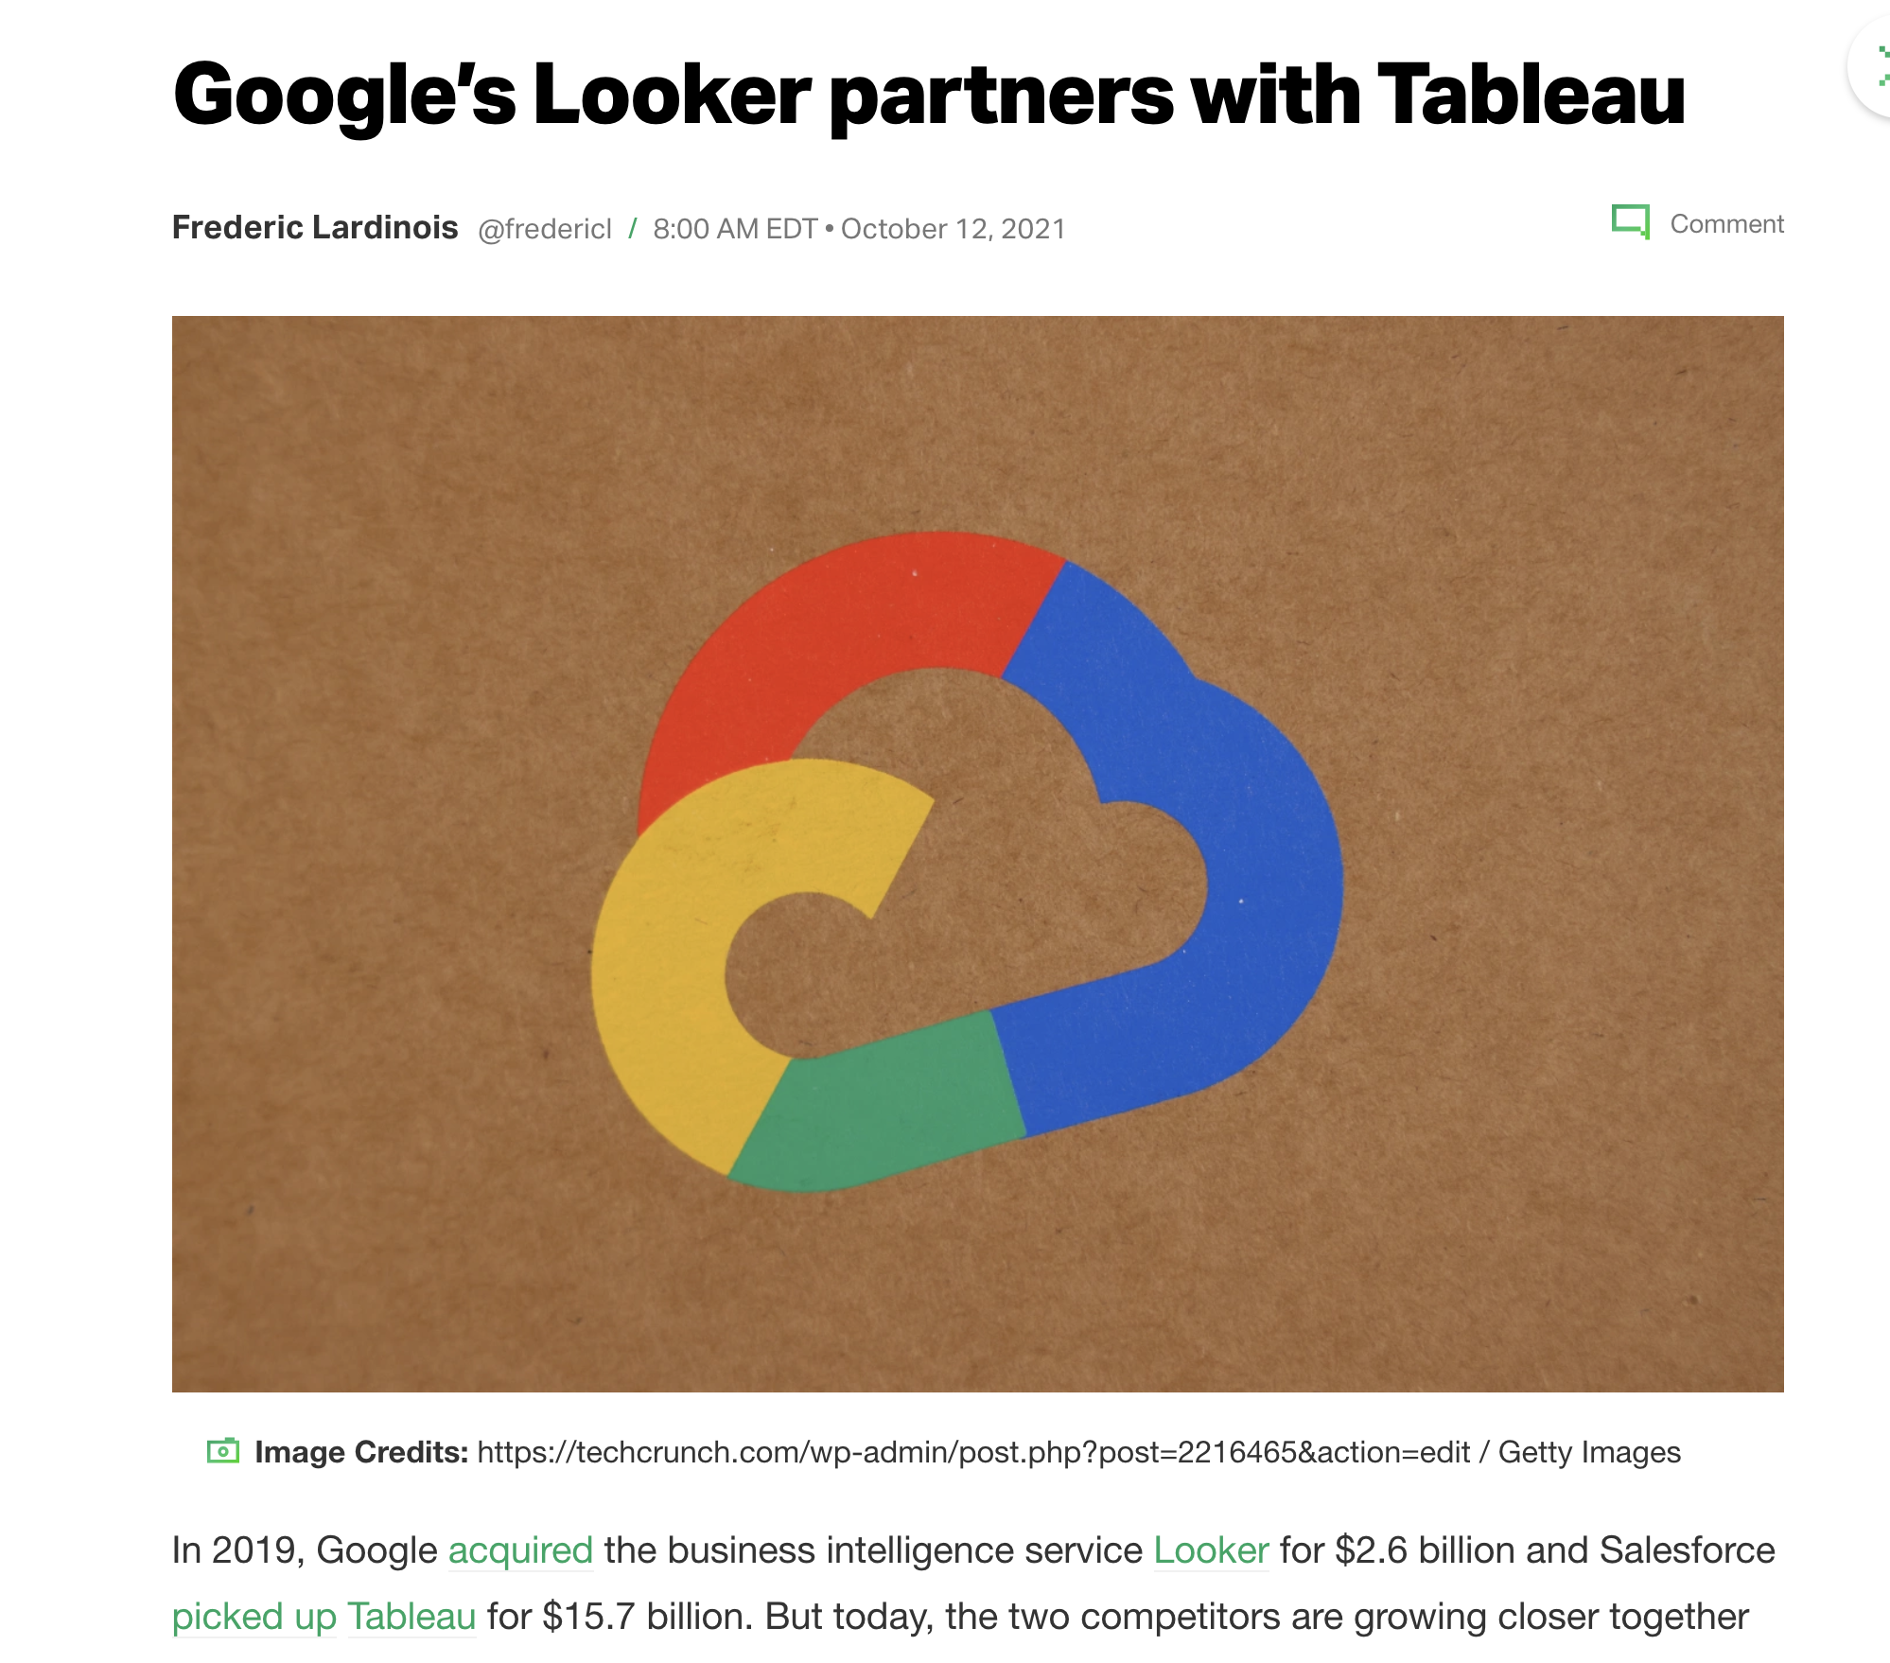

Slide 55
Class 10
Data Perspective on Data Interfaces

Slide 56
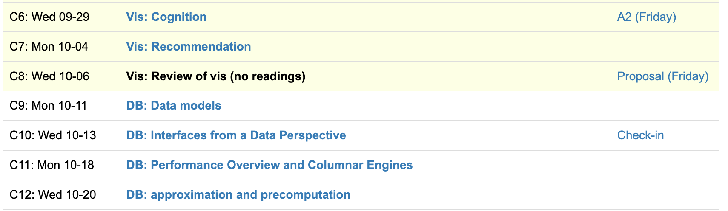
Logistics
Check-ins this week
Presentations starting next week
In-class or not? Votes lean toward in-class. Decision by Friday.

Slide 57
Leo Zhicheng Liu

Slide 58
Each group assigns notetaker
Where does Ermac draw the line between the visualization library and the database? Where does Tableau draw the line?
Notes:
How did you pick the other vis language?

Slide 59

Support your colleagues
for speaking up!

Slide 60
Each group assigns notetaker
Where does Ermac draw the line between the visualization library and the database? Where does Tableau draw the line?
Notes:
How did you pick the other vis language?

Slide 61
Class 9
Data Models

Slide 62
Logistics
Check-ins this week
Shifting to data processing topics
Midterm reviews
Review “grades” out tomorrow

Slide 63
Each group assigns notetaker
Identify an application or interaction that is hard to support under a relational model but easy to support under a non-relational model (specify what model).
Notes:
How did you pick the other vis language?

Slide 64

Support your colleagues
for speaking up!

Slide 65
Each group assigns notetaker
Identify an application or interaction that is hard to support under a relational model but easy to support under a non-relational model (specify what model).
Notes:
How did you pick the other vis language?

Slide 66
Class 8
Review/Breather

Slide 67
Turn video on,
enable mic

Slide 68
Logistics
Proposals due Friday
Sign up for Check-ins for next week (during OH and Thurs)

Slide 69
Each group assigns notetaker
Discuss a potential language for a domain we haven’t read about.
Consider the concepts covered in class so far
Notes:
How did you pick the other vis language?

Slide 70

Support your colleagues
for speaking up!

Slide 71
Each group assigns notetaker
Discuss a potential language for a domain we haven’t read about.
Consider the concepts covered in class so far
Notes:
How did you pick the other vis language?

Slide 72
Class 7
Recs

Slide 73
Turn video on,
enable mic
Is it winter already???
Discuss

Slide 74
Logistics
Proposals due Friday
No reviews Wednesday

Slide 75
Each group assigns notetaker
In human data interfaces, what should be the role of recommendations? What tasks?
Construct a scenario. Discuss the gaps wrt the readings.
Notes:
How did you pick the other vis language?

Slide 76

Support your colleagues
for speaking up!

Slide 77
Each group assigns notetaker
In human data interfaces, what should be the role of recommendations? What tasks?
Construct a scenario. Discuss the gaps wrt the readings.
Notes:
How did you pick the other vis language?

Slide 78
Class 6
Cognition

Slide 79
Turn video on,
enable mic
What is your favorite
sandwich (broadly construed)

Slide 80

CS Distinguished Lecture
Mon 10/4 11:30AM

Slide 81
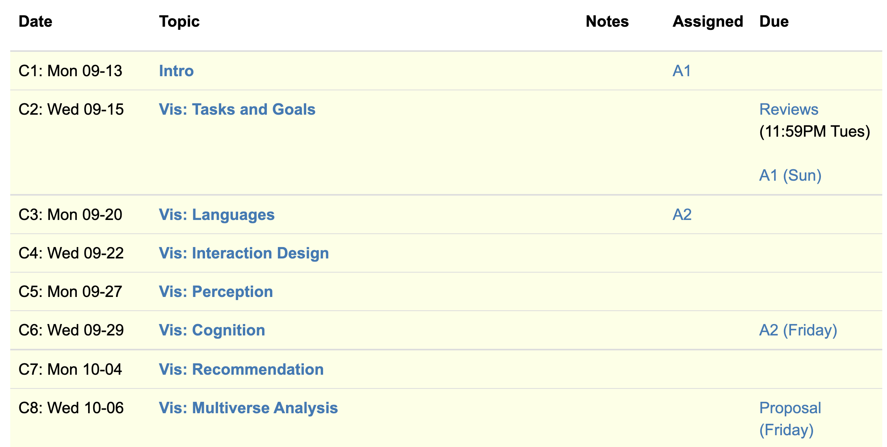
Logistics
A2 due Friday, Proposals next Friday
2nd guest speaker: Leo from Graphistry

Slide 82
Eirik Bakke: Spreadsheets

Slide 83
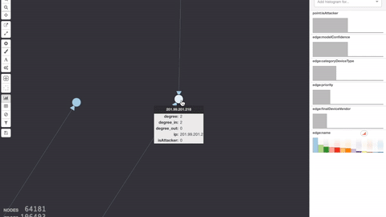
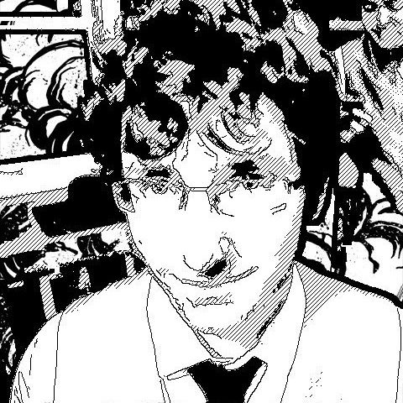
Leo Meyerov: Graph Analytics via GPU

Slide 84
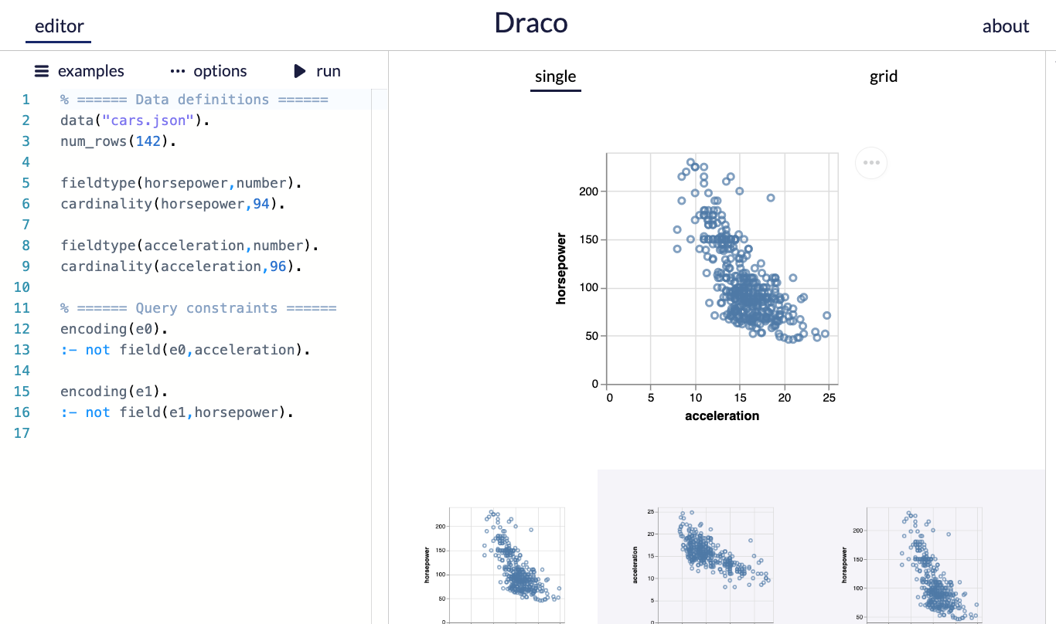
A2
Use the draco demo editor
Paper describes ASP language

Slide 85
Bridging Ideas and Reality
CS is (mostly) an engineering discipline
Ideas are ambiguous, many ways to ground in reality
“Draco could make data scientist lives better”
Project proposal: disambiguate.
Hypothesis formulation: a way to disambiguate

Slide 86
Overview. Research Project 50%
BAD
“We want to build X with features A, B, C”
Ignores why it’s worthwhile and new
Confuses artifact as the goal
GOOD
“Evidence shows Y is important, but existing work have a gap in X. We show that to fill the gap, A, B, and C and needed”
Grounded in related work and user needs
Explains why A, B, and C are necessary

Slide 87
Overview. Research Project 50%
BETTER
“Evidence shows that Y is imptnt, but existing work have a gap in X. ”
“If we do A, then we expect METRIC to CHANGE”
“If we do B, then we expect METRIC to CHANGE”
…

Slide 88
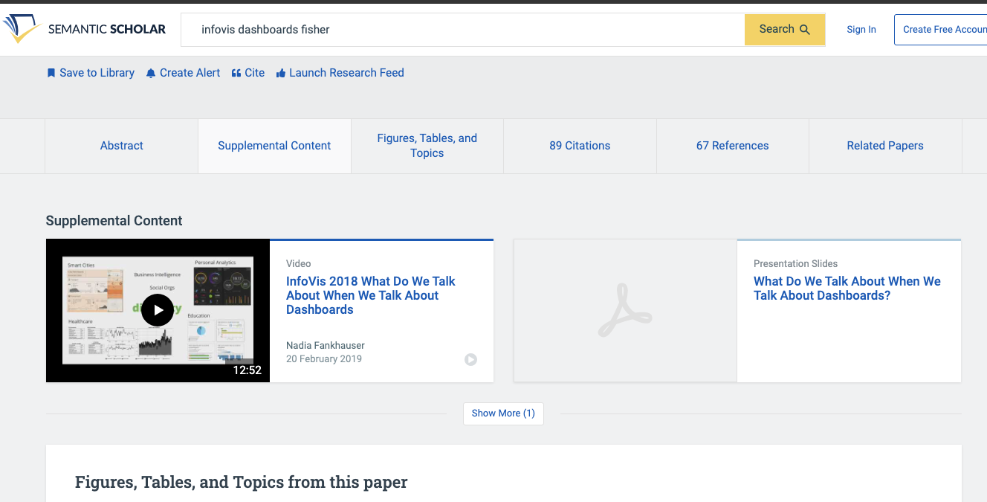

Slide 89
Each group assigns notetaker
This paper applied bayesian cognition to estimating a mean value. Identify another vis setting where the model could be applied. Formulate a hypothesis and sketch an experiment design.
Hypothesis: “Given conditions A, B is METRIC different?”
Notes:
How did you pick the other vis language?

Slide 90
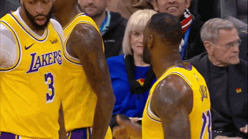
Support your colleagues
for speaking up!

Slide 91
Each group assigns notetaker
This paper applied bayesian cognition to estimating a mean value. Identify another vis setting where the model could be applied. Formulate a hypothesis and sketch an experiment design.
Hypothesis: “Given conditions A, B is METRIC different?”

Slide 92
Class 5
Perception

Slide 93
Turn video on,
enable mic
What’s your favorite restaurant
within a 20 min radius?

Slide 94
Logistics
A2 due Friday
Think about project proposal. 2 office hours left!

Slide 95
Projects
Build a system
Design an algorithm
Evaluate a design
Study perception/cognition
Survey
Etc.
Some project ideas

Slide 96
Today
Background:
Cleveland & McGill
AMT
Example of another perception experiment
The paper!

Slide 97
How complex?
uh...kind of complex?
Visualization Complexity Score
(this paper)
0.01
0.83
Visual complexity is subjective
Hard to articulate
Notes:
It is clear that the complexity of the chart can affect how easily , and accurately the user can extract information from the chart, at a glance.
We could imagine simplifying or zooming in or smoothing a line chart if it’s too complex, but we need to know that it IS too complex first. But what does complex even mean? Visual complexity can be subjective, and we can’t directy ask users to quantify it for us
This paper proposes ONE possible visualization complexity score, that takes a line chart as input and outputs a score that measures its perceptual complexity. For instance, a lower score for the simple horizontal line, and a higher number of a bunch of squiggles.

Slide 98
Adding Synthetic Noise
Notes:
In this experiment, we start with several simple, representative signals and measure their PAE. We see the line has very very low PAE, and it increases with the complexity of the signal.
We then add random synthetic noise to the signals, and see that the entropy correspondingly increases.
In fact, if we plot the amount of noise on the x axis, and the PAE on the Y axis, we see that there is a very strong correlation
Using this methodology, we find that PAE is correlated with synthetic noise. Now synthetic noise doesn’t necessarily correspond with perceived complexity

Slide 99
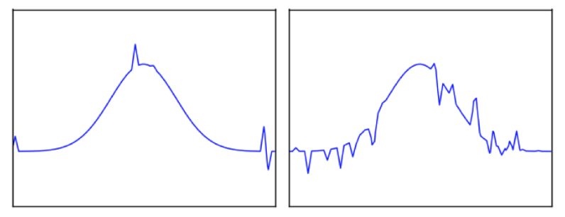
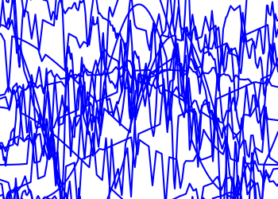
Task: Pick the Original
Glance time
Initial chart shown
Pause time
Mask shown
Pick time
User picks options
Notes:
If you glance over as the visualization changes, can you identify if something changed?
Mask to “clear the perceptual cache” to make sure its due to cognitive rather than low level perceptual pattern matching (after effects)
~3-4 seconds pick time in practice

Slide 100
Ready?
3
2
1

Slide 101
Pick the Original
Accuracy
Reduced
Increased
Change in PAE
Notes:
52 users, randomized order.

Slide 102
Pick the Original
Accuracy
Reduced
Increased
Change in PAE
Initial PAE

Slide 103
Pick the Original
Accuracy
Reduced
Increased
Change in PAE
Initial PAE
Notes:
It’s reminiscent of JND, but is not a formal staircase study
We also evaluated the effects of glance time and the results are reported in the paper.
(H3.1) Entropy of the initial chart (Z = 2.42, p < 0.05);
(H3.2) Magnitude of PAE difference between the two charts (Z = −5.08, p < 0.001);
(H3.3) Sign of the PAE dif- ference between the two charts (Z = −8.06, p < 0.001); and
(H3.4) Baseline function (χ2(3) = 9.32, p < 0.05).
There were 52 participants

Slide 104
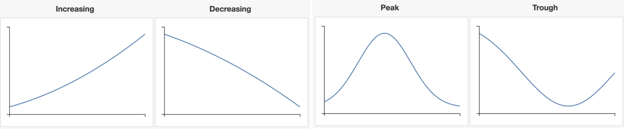
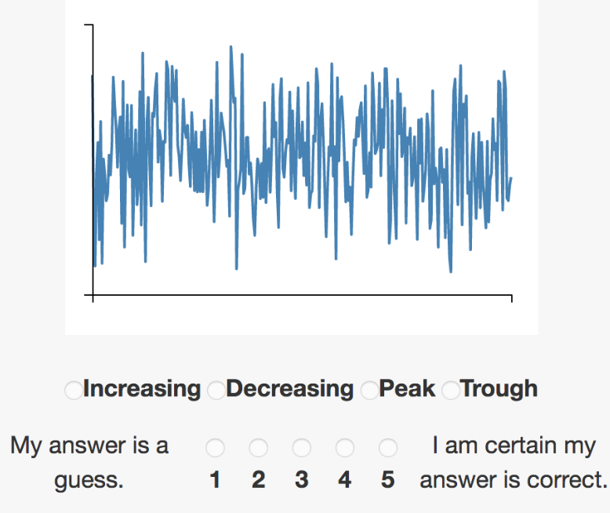
Pick The Signal
Which base function is most representative of chart?
Notes:
500ms glance time (2-4 fixations)
47 total participants,

Slide 105
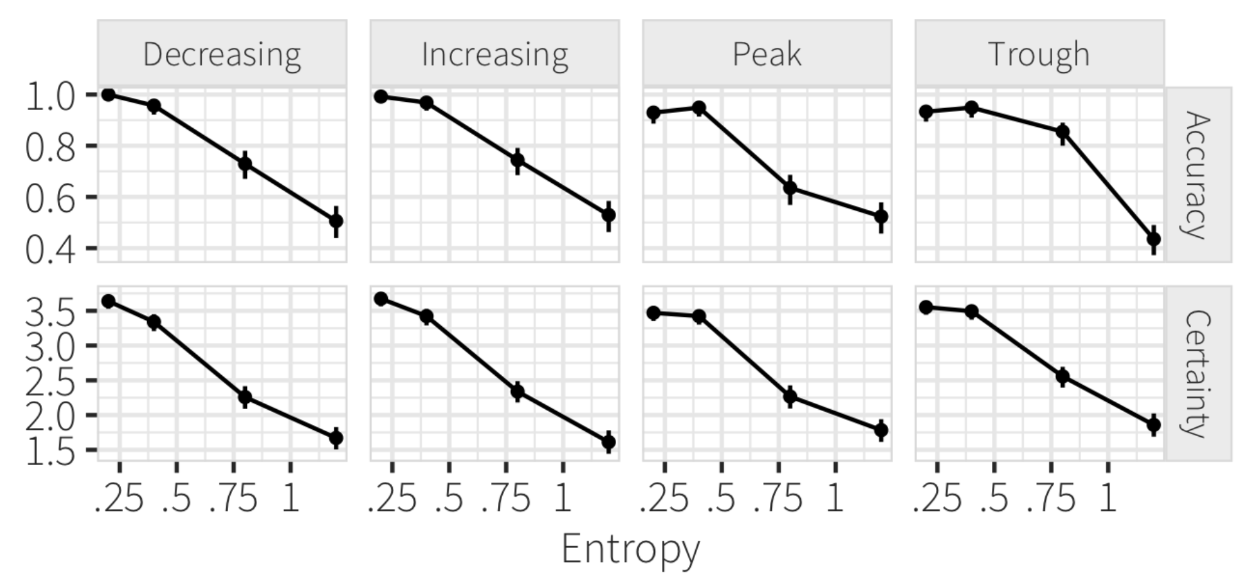
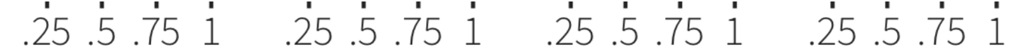
Pick The Signal
PAE
PAE
Notes:
significant results, with clearly high effect size (Z = 25.75, p < 0.001)
For each base function, we showed users 5 versions at each of four PAE levels (0.2, 0.4, 0.8, 1.2), resulting in a 4 × 4 × 5 = 80 factorial design.
There were 47 total participants,

Slide 106
Each group assigns notetaker
What would be a possible follow-up or alternative graphical perception study? Phrase it in the form of a question, and design an experiment for it.
Notes:
How did you pick the other vis language?

Slide 107
Support your colleagues
for speaking up!

Slide 108
Each group assigns notetaker
What would be a possible follow-up or alternative graphical perception study? Phrase it in the form of a question, and design an experiment for it.

Slide 109
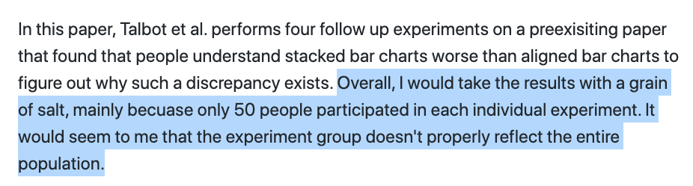

Slide 110
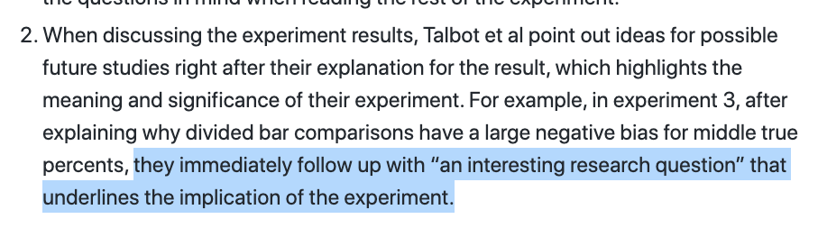

Slide 112
Class 4
Languages, Interaction

Slide 113
Turn video on,
enable mic
Share a book you recently
read/listened to

Slide 114
Logistics
A2 released.
Think about project proposal. 2 office hours left!

Slide 115
Each group assigns notetaker
G1: How does the instrumental interactions model apply to interactive visualizations?
G3, 4: Where do interface languages fit into the instrumental interactions model?
Notes:
How did you pick the other vis language?

Slide 116

Support your colleagues
for speaking up!

Slide 117
Each group assigns notetaker
G1, 2: How does the instrumental interactions model apply to interactive visualizations?
G3, 4: Where do interface languages fit into the instrumental interactions model?

Slide 118
Interactive Interfaces as Domain Specific Languages

Slide 120
Class 3
Languages

Slide 121
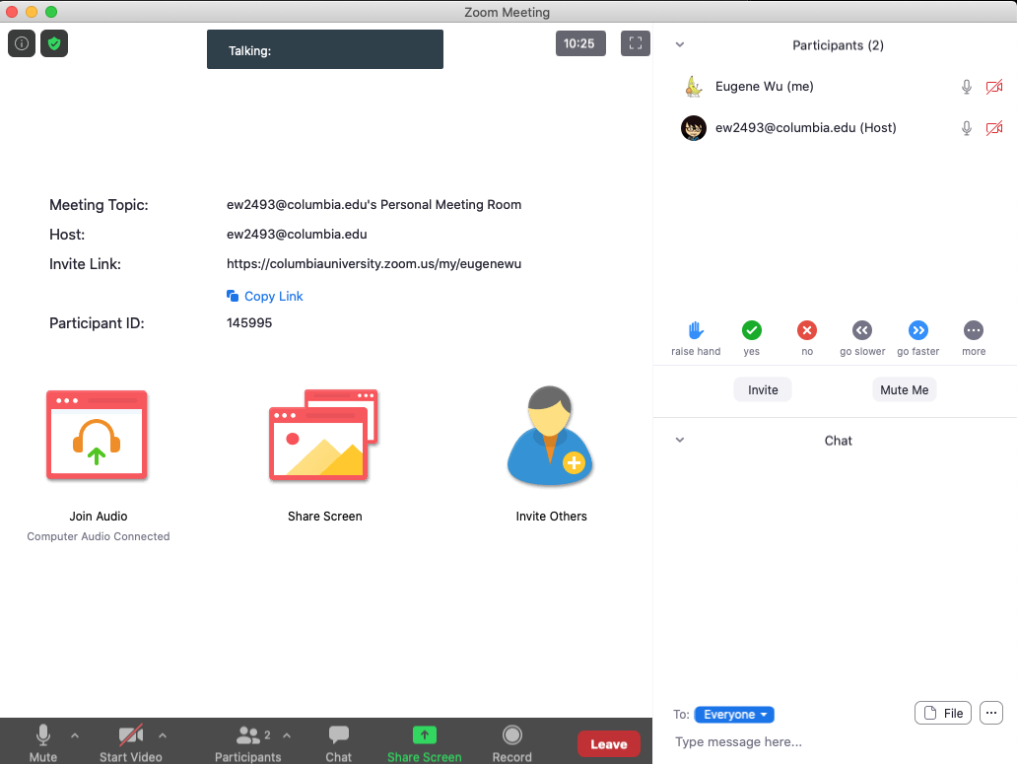

Turn video on,
enable mic & say:
“Hi, this is _(name)_,
I usually eat ________ for lunch”
Click when done
Participants
Chat

Slide 122
Logistics
A1 was due last night
A2 released.

Slide 123
Each group assigns notetaker
G1 and 2: What criteria makes a HDI language good? Put the criteria into action: pick a domain/task and make up a language.
G3 and 4: discuss the strengths and weaknesses of how the paper is communicated. Share the top strength and top weakness.
Notetaker shares what you came up with and the process.
Notes:
How did you pick the other vis language?

Slide 124
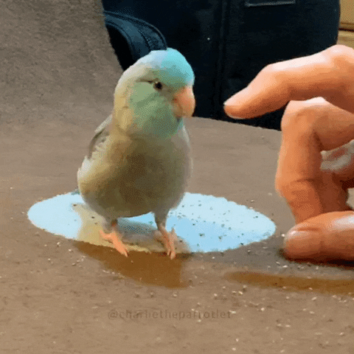
Support your colleagues
for speaking up
A quick thanks or follow up
is great

Slide 125
Each group assigns notetaker
G1 and 2: What criteria makes a HDI language good? Pick a domain/task and come up with a language.
G3 and 4: discuss the strengths and weaknesses of how the paper is communicated. Share the top strength and top weakness.
Notetaker shares what you came up with and the process.

Slide 126
Technique
Is it correct?
Does it make sense?
Is it as simple as possible?
Are decisions unnecessarily complex?

Slide 127
Comunication
What is the appropriate audience?
How well do they justify
Design decisions?
Technical approach?
The problem itself?

Slide 128
Experiments
What SHOULD have been done?
How should it be measured?

Slide 129
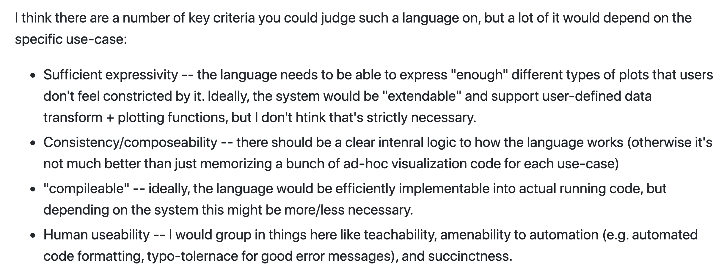

Slide 130
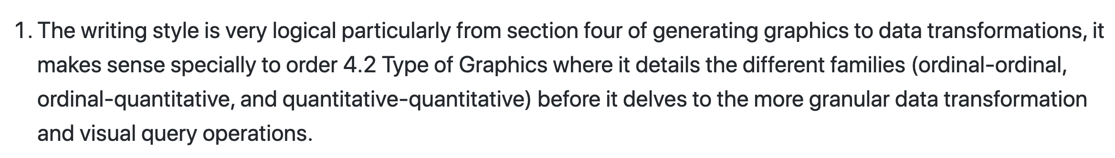

Slide 131
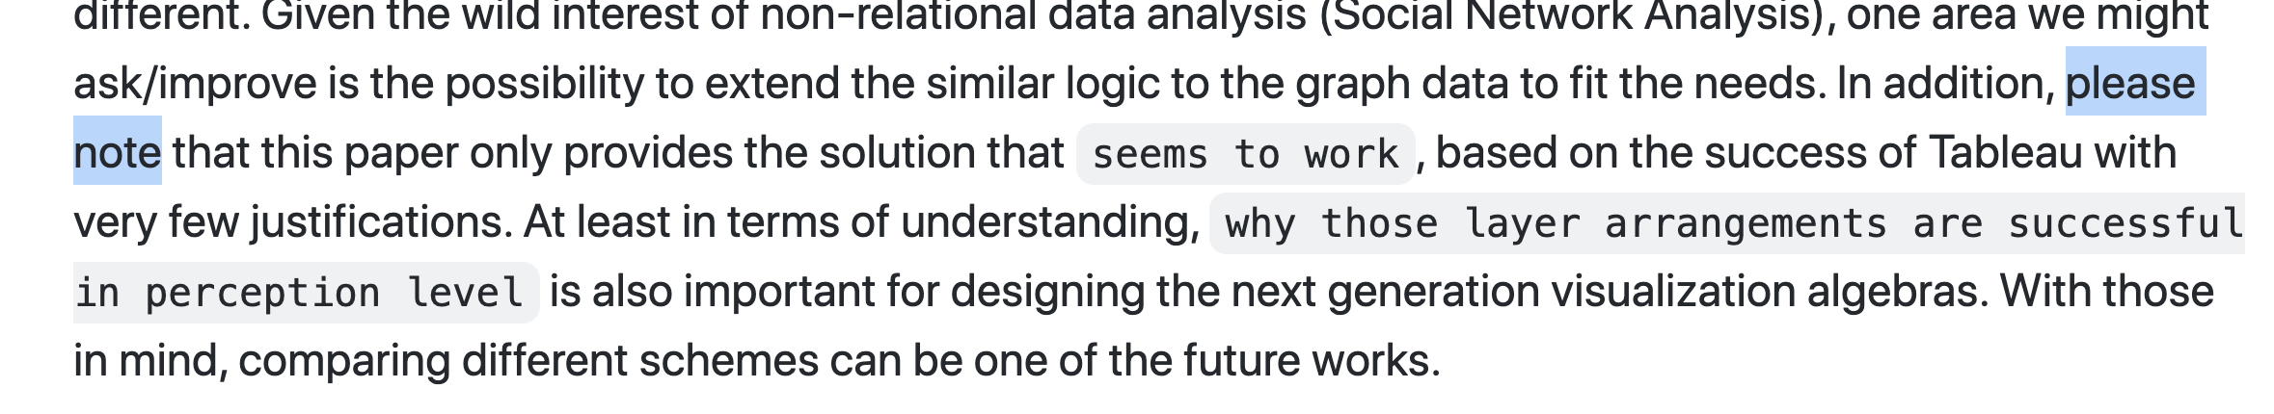

Slide 132
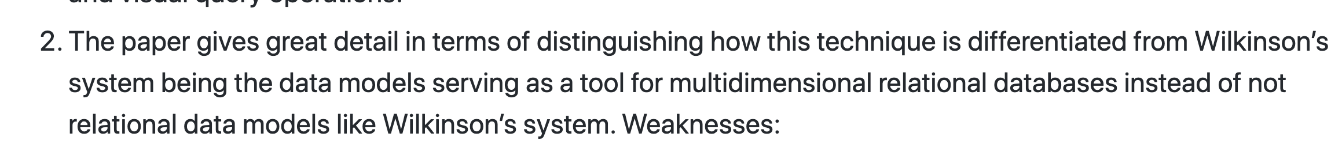

Slide 133
Class 2
Tasks

Slide 134
Discussion prompt:
Recent book that you find memorable

Slide 135


Slide 136
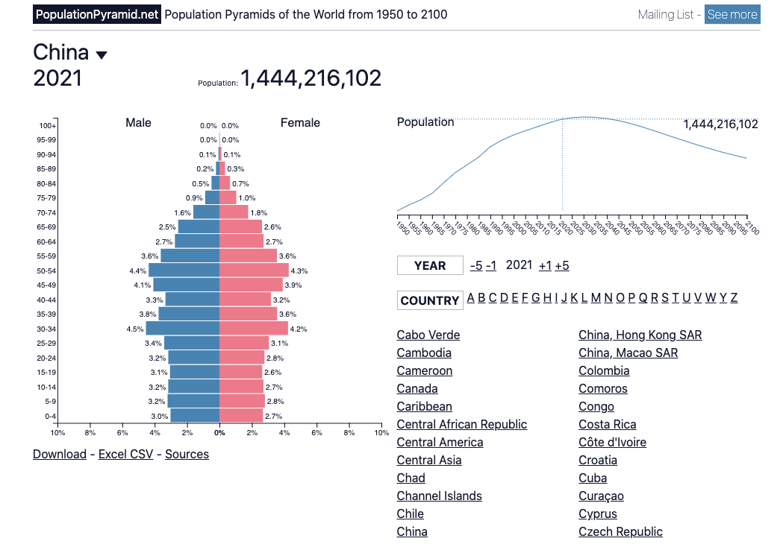

Slide 137
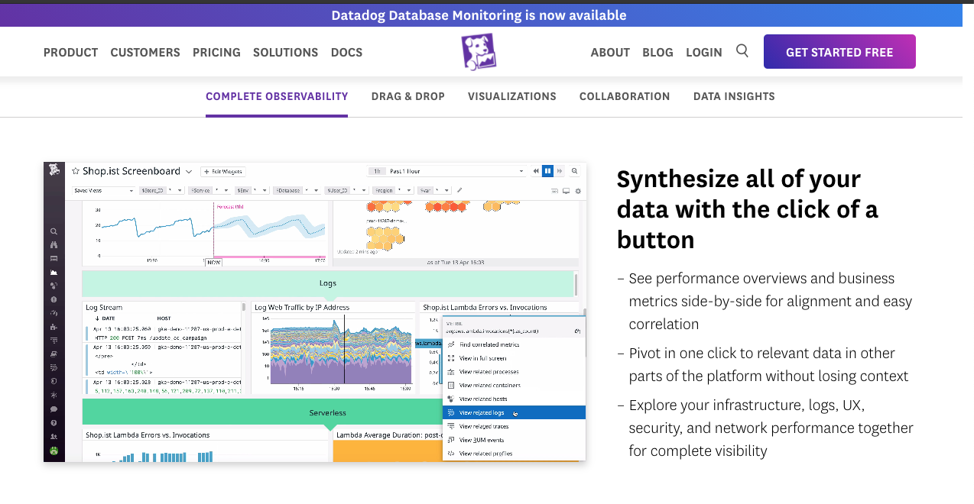

Slide 138
Each group assigns notetaker
Groups of 4:
You back-fitted task descriptions from a visualization. Discuss your process, what made it easy/difficult, and reflect on the applicability of the task typology.
Bonus, choose a visualization and task to share with the class. (connect to zoom, share screen)

Slide 139
Support your colleagues
for speaking up
A quick thanks or follow up
is great

Slide 140
Each group assigns notetaker
Groups of 4:
Discuss and share the visualization and task description you created in the review.
Choose one that notetaker will share with the class
(connect to zoom, share screen)

Slide 141
TODOs
A1!!

